Slide 1

INFO 5100 FINAL PROJECT
SUMMER CAMP MANAGEMENT
Group 2
Vrinda shinde
Chitra Periya
Yash Jalan
Kalyani Aray

Slide 2

OVERVIEW
This Project aims to create a portal which helps student to enroll in Summer Camp

Slide 3
PROBLEM STATEMENT
Many parent face problem to register their kids for the summer Camps. Our attempt to help them ease the process

Slide 4



SCHOOL ENTERPRISE- ROLES
Admin
Parent
Student

Slide 5



CAMP ENTERPRISE- ROLES
Camper
Admin
Staff

Slide 6


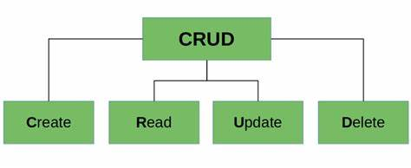

WORK REQUEST
Export Data
Data Visualisation
Parent CRUD
Student CRUD

Slide 7




WORK REQUEST
Camp Registration
FeedBack
Camp Report
School Report

Slide 8
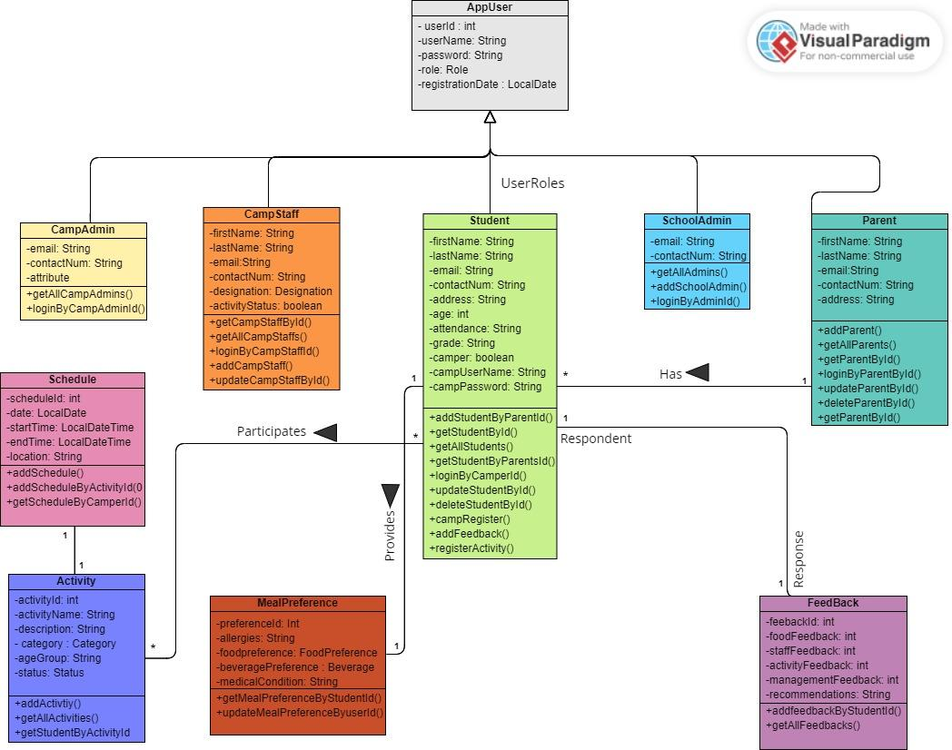
CLASS
DIAGRAM

Slide 9
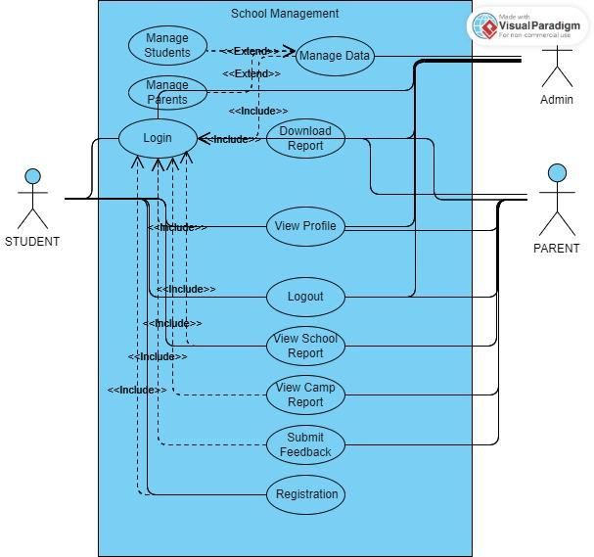
SCHOOL
ENTERPRISE
USE CASE
DIAGRAM

Slide 10
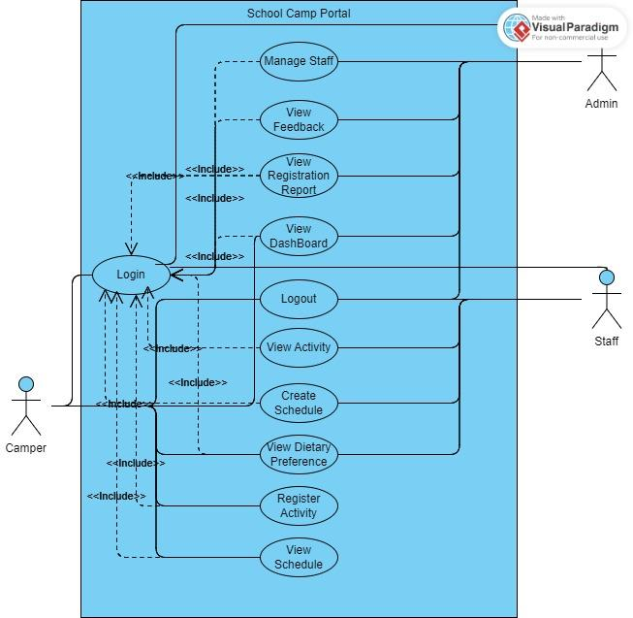
CAMP
ENTERPRISE
USE CASE
DIAGRAM

Slide 11
THANKYOU!

